Slide 2
Dependency & World-System theory:
A critiques & new directions Latin America perspective
By
James Petaras
WELCOME
Presenter
Mr. Ajit Thapa
^{2nd January} ^{2022 Sunday}

Slide 3

James Petras
James Petras born 17 January 1937 is a retired Bartle Professor (Emeritus) of Sociology at Binghamton University in Binghamton New York
Adjunct professor at Saint Mary’s University , Halifax , Nova Scotia , Canada , who has published on political issues with particular focus on Latino America
Petras - a Greek-American - received his B.A. from Boston University and Ph.D. from the University of California at Berkely
Petras is the author of more than 60 books published in 29 languages, and over 600 articles in professional journals, including the American Sociological Review, British Journal of Sociology, Social Research and Journal of Peasant Studies. He has published over 2,000 articles in publications such as the New York Times, The Guardian, The Nation, Christian Science Monitor, Foreign Policy, New Left Review, Partisan Review, Canadian Dimension, and Le Monde Diplomatique.
He has a long history of commitment to social justice, working in particular with the Brazilian Landless Workers Movement for 11 years.

Slide 4
About World system theory
World system theory (so designated by one of its major practitioners, Immanuel Wallerstein, 1975) is derived from the intellectual heritage found in the critique of the developmentalist perspective of
“Liberal political economy”.
“This critique was articulated in the work of Paul Baran (1957), A. G. Frank (1967, 1969), Theotônio Dos Santos (1971), and other dependency theorists (for à recent review and effort to defend the dependency perspective, see Cardoso, 1977).
Recently, dependency has achieved a new status in the attention given to The "unequal exchange" theses of Arghiri Emmanuel (1972), Samir Amin's discussion (1974) of the "accumulation of world capital," and Immanuel Wallerstein's historical interpretation (1974, 1976) of the rise of a "single capitalist world economy."

Slide 5
world systems approach
The basic framework of a world systems theorist is extraordinarily simple the problematic to be explained is the fact that there exist different stages or Global Economy levels of national development within what appears to be a unified global economy.
This notion gives rise to the basic categories of analysis: (Core, semi-periphery and periphery; core and periphery; metropole and satellite. (A colonial or imperial power, considered in relation to its colonies or empire /A satellite state is a country that is formally independent in the world, but under heavy political, economic and military influence or control from another country. …..)
The real innovation of the world systems approach lies in the choice of the primary unit of analysis - the capitalist world economy.
An Example, can be explained as "efforts to alter or preserve a position within the world economy which is to the advantage or disadvantage of particular groups located within a particular state“ Zimbabwe example

Slide 6
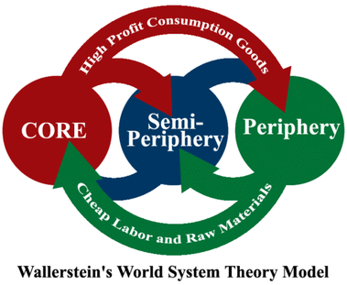
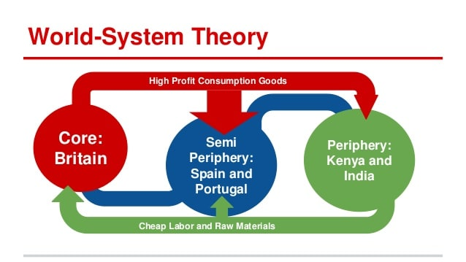
Three main zones…………old lecture
Core,
Semi periphery,
And Periphery tied together by world market trade in bulk commodities that are necessities for everyday consumption.
Each major zone of the world economy has an economic structure based upon its particular mixture of economic activities (e.g., industry plus differentiated agriculture in the core; monoculture in the periphery) and its characteristic form of "labor control"

Slide 7
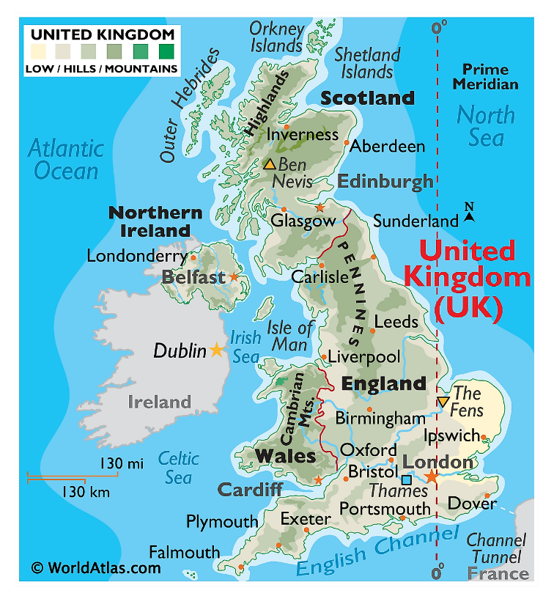
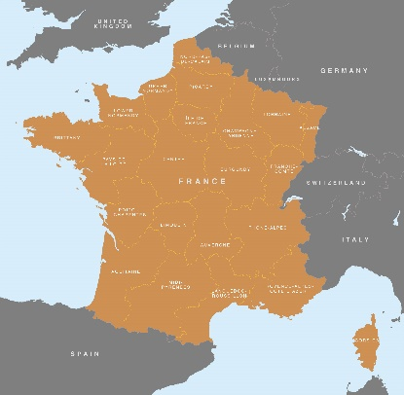
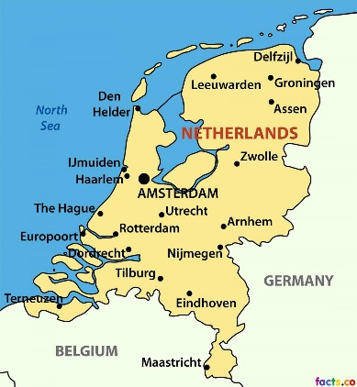
Wallerstein divides the world into four categories of the regions consisting of a few countries. These categories are reflective of the political and economic characteristics and also the relative positions of the countries in the world system.
The four categories of world are as follows:
1. The Core:
During 1450-1670, the north-western Europe developed as the first core region. This region consisted of England, France and Holland.
The states in this region developed strong governments and bureaucracies which helped them to have control over inter­national commerce and extract surpluses from this trade for their own benefit.
As a result of the crisis of feudalism, the peasants who were rendered landless and had to migrate to cities, provided cheap labour for urban industry which helped its development.

Slide 8
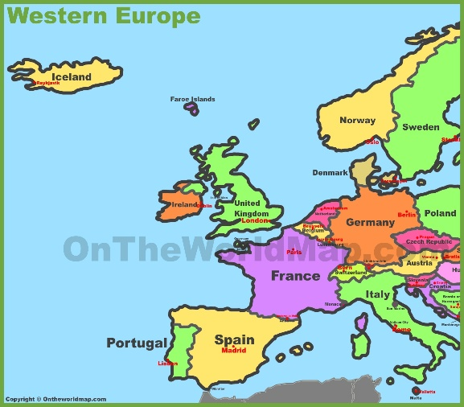
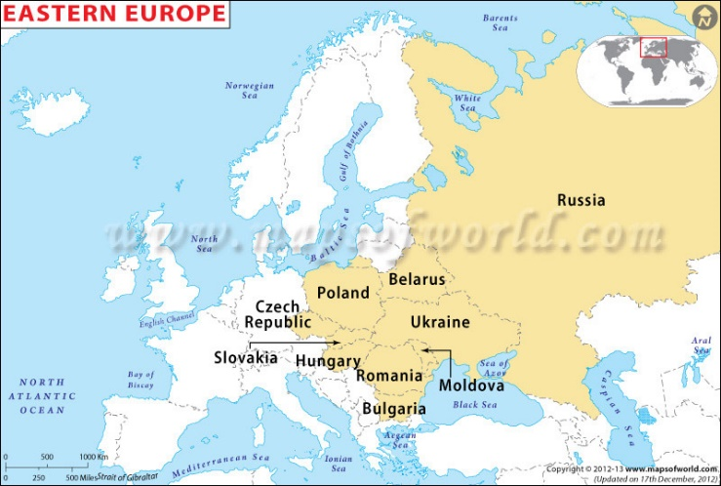
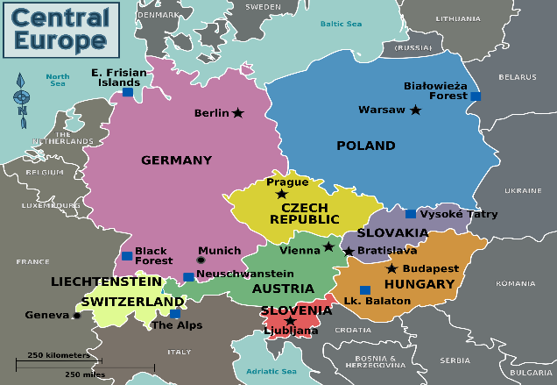
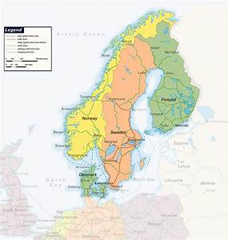
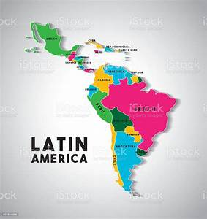
2. The Periphery:
The countries put in this category are the East European countries (especially Poland) and Latin America.
These countries lacked their own strong governments and were controlled by other states.
They exported raw material to the core region. They extracted much of the capital surpluses of these countries through migrant exchange.
The labour in this region was forced and made to provide cheaper raw material to be exported to Europe.

Slide 9
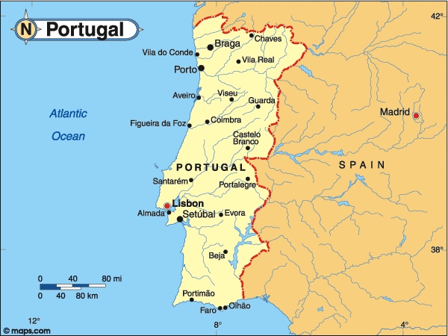
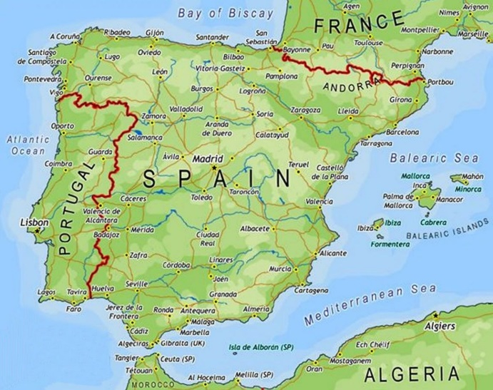
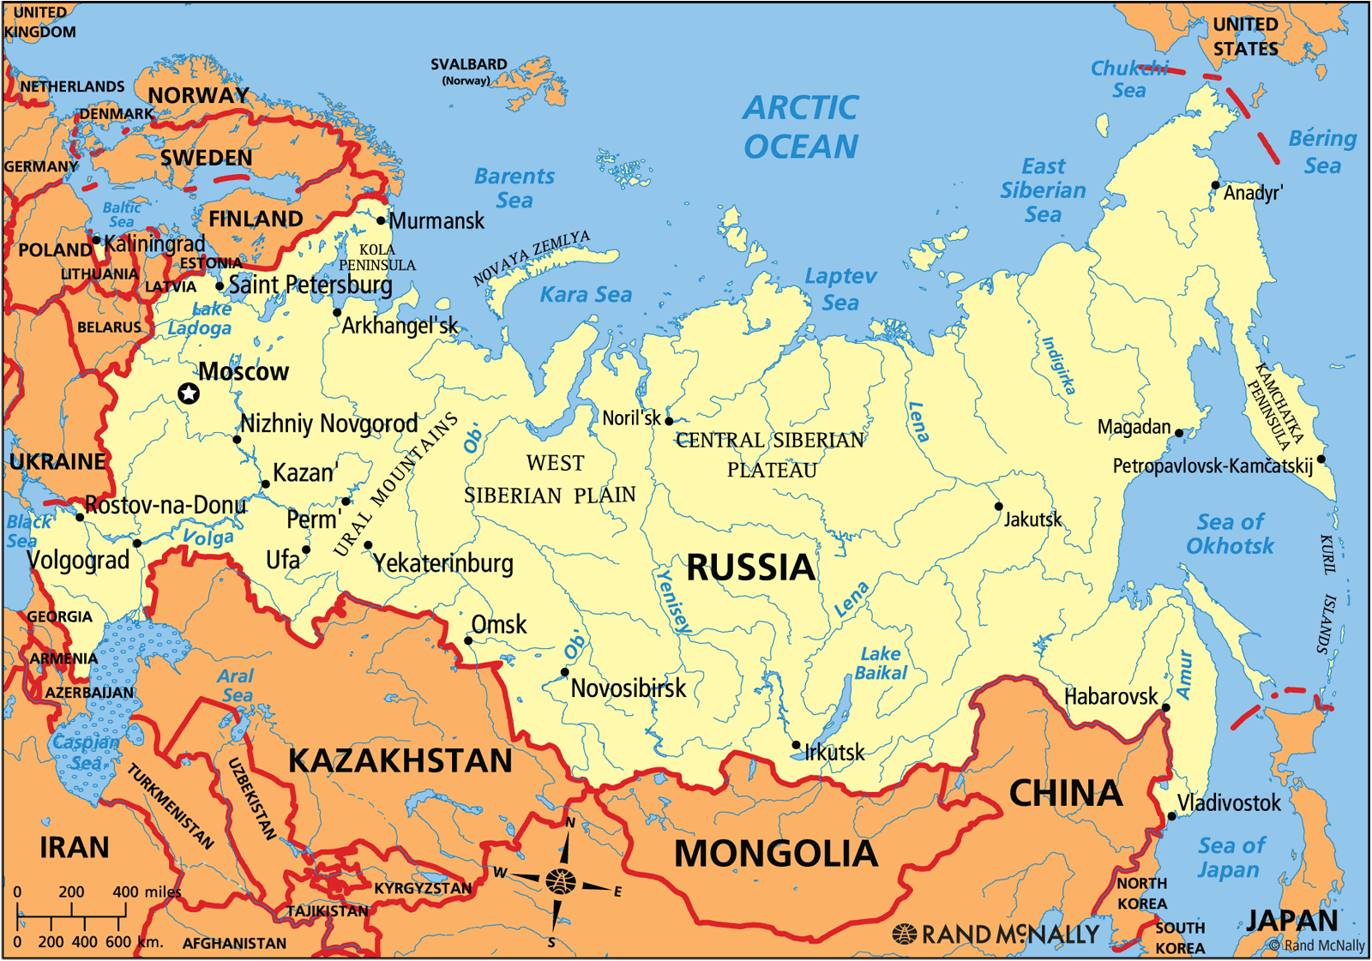
3. Semi-periphery:
This region lies between the core and the periphery regions.
It consists of the countries of the core region which are facing decline in their economy and those of the periphery whose economy is improving.
Wallerstein cites the example of Portugal and Spain, which slipped from their core position to that of semi-peripheries.
The core exploited the semi-periphery, which exploited the peripheries.
4. External Areas:
These are the areas which maintain their own economic system.
The internal trade is given importance by the countries of this region. Russia is the best example of this region.

Slide 10
What is important? & Centre theme
To notice is the direction of generalization in world systems theory, for that is the key to understanding the approach.
Specific events within the world system are to be explained in terms of the (demands of the system as a whole.)
Actors are acting, not for their immediate concrete interests, but because the system dictates that they act.
अभिनेताहरू अभिनय गर्दछन्, तिनीहरूको तत्काल ठोस चासोको लागि होइन, तर प्रणालीले उनीहरूलfO काम गर्ने आदेश दिन्छ।
The central theme of the world systems approach is the scheme that core regions exploit peripheral regions through various mechanisms of unequal exchange.

Slide 11
Core- peripheral capitalism
In fact, the world systems conceptualization is distinguished by an effort to ground unequal exchange in a labor theory of value.
This labor theory of value forms the basis of an attempt to explain how surplus value extracted from the working class of the periphery is transferred to core regions;
As a means of extracting surplus, unequal exchange is not only different from the extended reproduction of capital that is characteristic of the core, but it is the principal contradiction of the modern capitalist world.
Amin and Wallerstein agree with Emmanuel regarding the centrality of wages; but they also draw attention to other differences between core capitalism and peripheral capitalism.
Given this analysis of world capitalism, the salient question for radical praxis becomes, "What can regions of peripheral capitalism do in order to mitigate or eliminate the effects of unequal exchange?"

Slide 12
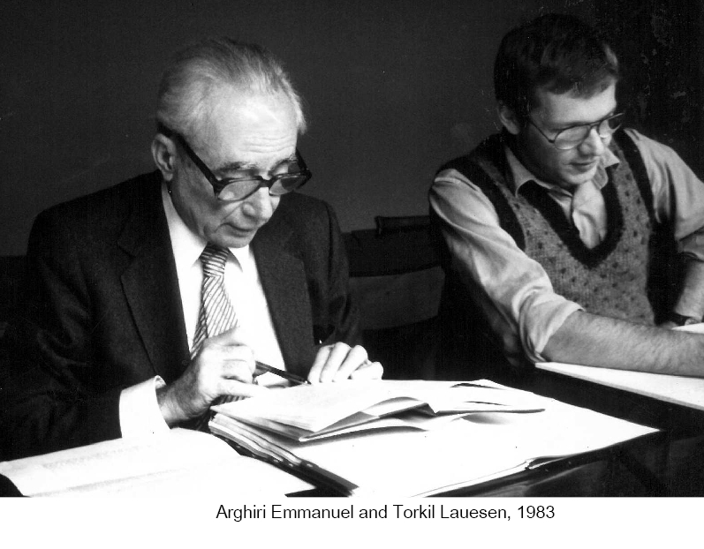
Emmanuel proposes
Emmanuel proposes taxes on exports and diversification ( Expansion) of production as two mechanism for accomplishing this goal. It is assumed that this excess surplus will be used for development purposes.
Emmanuel argues that since somebody has to benefit from these low wages, and since it is desired that foreign consumers not be the beneficiaries, it is best that the benefits accrue to national capitalists.

Slide 13
“AN EVALUATION OF WORLD SYSTEMS APPROACHES"
विश्व स्तरमा उभिएका सामाजिक शक्तिहरू
To conceptualize the issues of the Third World in terms of dependency or as part of a world system is to lose sight of the most decisive processes of class formation and social relations which precipitate change, and the particular configurations ( Pattern) of social forces which emerge on a world scale.
It is not the world system that precipitates change in social relations, but rather social forces that emerge and extend their activities that produce the world market.
The transformations formed within societies by their insert in the region market must be seen as an ongoing reciprocal relationship: between the forces and relations of production within a social formation and those that operate through the world Market.

Slide 14
The principal features
The principal features which characterize capitalist development have varied considerably over time:
a. The process of primitive accumulation ( Original Gathering),
b. The growth of commercial capital,
c. The expansion and growth of industrial
d. Later Financial capital each have their own laws of development,
e. Generating their own class structures and appropriate state organization

Slide 15
capitalist world market
The manner in which the fundamental contradiction (between anticapitalist social formations and capitalist world market) will be resolved depends on the evolution of class forces within the country and the proliferation of revolutionary forces in other societies.
The capitalist world market thus must be translated from a set of static institutions and described essentially for what it is: a series of class relationships that have their anchorage and instrumentation in the imperialist states.
The world market operates through the class directed institutions that impose the manipulative class relationship throughout the world.
The world capitalist system can best be analyzed by examining the hegemonic class relationship and imperialist state and the conflicting class relationships that emerge in each social formation.
capitalist world market
Any economy is capitalist as long as private individuals control the factors of production. A purely capitalist economy is also a free market economy, meaning the law of supply and demand, rather than a central government, regulates production, labor, and the marketplace
Capitalism is an economic system in which private individuals or businesses own capital goods.
The production of goods and services is based on supply and demand in the general market—known as a market economy —rather than through central planning—known as a planned economy or command economy

Slide 16
“NEW DIRECTIONS”
The political economy of the periphery is moving in a new direction which involves redefining;
a. The problematic,
b. Reformulating the key concepts,
c. Developing a more dynamic and inclusive analytical framework
Some of issues and problems
1.
a. The previous problematic, which focused on development, abstracted from the social relations of production and emphasized to a great degree the extension and increase in productive forces, the result has been to down.
b. Grade the degree to which labor is the creator of value and the source of wealth.
c. The focus on social relations of production allows us to focus on the issue of exploitation and to focus on the forms and techniques by which labor is degraded, as well as to understand the forms by which exploitative relations of production can be transformed.

Slide 17
2.
By redefining the problematic of political economy away from development to exploitation,
we thus are required to reformulate the key concepts with which we analyze the new problematic.
Notions such as dependence and modernization which operate to explain or discuss development are inappropriate.
Rather, our focus should be on the class relationships, both at the internal as well as the international level, and the types of class- relationships which are engendered in the process of accumulation.

Slide 18
(3)
These class relationships, however, are evolving phenomena, products of changes in the level and forms of capitalist development in the core;
The impact of these changes in the core on the productive systems and class forces in the periphery in turn produce impacts back on the core from the class forces in periphery, modifying or transforming the relationship.
The Notion is one of reciprocating interplay between conflicting and collaborative classes which reproduce or refashion the economy and state structures through which they operate.
(4)
This approach rejects aggregate notions of national interest in defining the critical actions between or within productive and state systems and focuses instead on the idea of class differentiation.
In the periphery this means that the problem is one of identifying the location of core capital within the class structure of peripheral societies and its relationship to the peripheral state and dominant classes. The implication here is that class cleavages are less confined to national boundaries and more involve class units which cut across national boundaries.

Slide 19
(5)
a. Thus, this approach locates the process of capital accumulation within the framework of class/state relationships
b. And it is within this schema, based on the determination of class coalitions and hegemonic influence that studies of income distribution and types of regimes could be fruitfully analyzed.
(6)
a. The problem of accumulation is not, however, local or national, but global;
b. moreover, the source of accumulation has become dissociated from the locus of accumulation,
c. thus creating the problems associated with movements of capital and the activities of the multinational corporations.
-We emphasize, however, that these movements and activities can best be understood through the
Notion of the imperial state,
The worldwide political network which facilitates the growth and expansion of" capital.
- Moreover, the overly economistic arguments put forth (mainly by economists) concerning the multinational corporations fail to account for the significant role of the imperial slate in establishing the prior and essential conditions for the flows of capital.
- Imperial state activity is essential to determining the scope, direction, growth, and survival of the multinational corporations.

Slide 20
Summery
The concerns of U.S. political scientists with a foreign policy advisory orientation toward political order, stability, and institution-building in this context are piecemeal intimations of the centrality of the imperial state in creating the conditions for long-term, large-scale expansion.
Lacking an harbor in the social relations of productive systems, developmental social scientists have obscured the centrality of exploitative social relations through general references to "systemic strains,"
“Development Imperatives (Obligation)" or derive the authoritarian attributes from vague cultural and historical determinations within peripheral society.

Slide 21
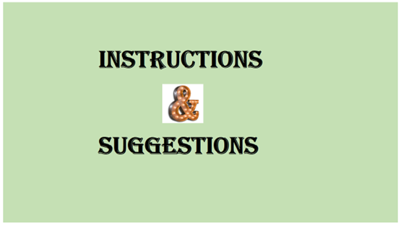
Class – Samrajayabad ra Nepal ko bhawisya ( Chaitanya Mishra )
Ms. Vhawana Acharya ( Presenter 1)
Ms Rosy Wagle ( Presenter 2)
Mr. Sunil Shrestha ( As Critique 1)
Ms Kopila serijocee Shrestha ( As critique 2)

